Slide 1
Market Equilibrium

Slide 2
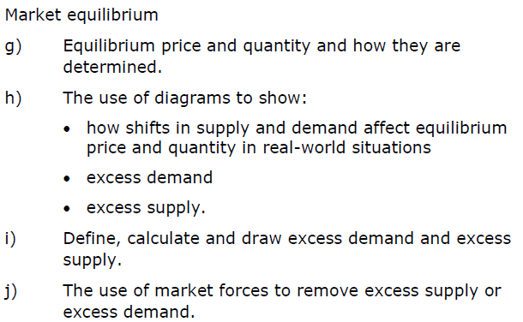
Learning objectives

Slide 3

Equilibrium
An equilibrium is defined as a state in which opposing forces or influences are balanced.

Slide 4
Market equilibrium introduction
Market equilibrium occurs at the price where quantity demanded equals to quantity supplied. At this point, the market is cleared of any shortage or surplus.
Price
($/km)
Market for Uber Rides
S
P
D
Q
Quantity of rides

Slide 5
Market equilibrium – activity
The market demand and supply of Uber rides is displayed below.
Price of rides ($/km) | Quantity demanded (Riders) | Quantity supplied (Drivers)
25 | 2,000 | 10,000
20 | 4,000 | 8,000
15 | 6,000 | 6,000
10 | 8,000 | 4,000
5 | 10,000 | 2,000
Plot the demand and supply curves.
Identify the equilibrium price & quantity.
What happens if the price is $10/km?
What happens if the price is $25/km?

Slide 6
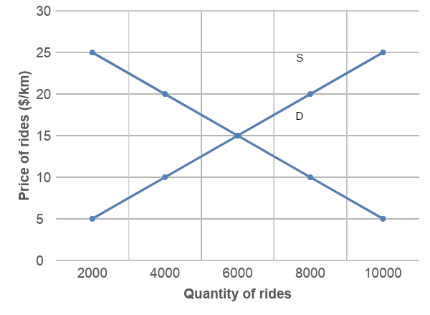
Market equilibrium – activity
Plot the demand and supply curves.
Market for Uber Rides
Price of rides ($/km) | Quantity demanded (Riders) | Quantity supplied (Drivers)
25 | 2,000 | 10,000
20 | 4,000 | 8,000
15 | 6,000 | 6,000
10 | 8,000 | 4,000
5 | 10,000 | 2,000
Market equilibrium

Slide 7
Market equilibrium – activity
Price of rides ($/km) | Quantity demanded (Riders) | Quantity supplied (Drivers)
25 | 2,000 | 10,000
20 | 4,000 | 8,000
15 | 6,000 | 6,000
10 | 8,000 | 4,000
5 | 10,000 | 2,000
Identify the equilibrium price & quantity.
Equilibrium price = $15
Equilibrium quantity = 6,000 rides
What happens if the price is $10/km?
Market shortage of 4,000 drivers.
What happens if the price is $25/km?
Market surplus of 8,000 drivers.

Slide 8
Market equilibrium
Price of rides ($/km) | Quantity demanded (Riders) | Quantity supplied (Drivers)
25 | 2,000 | 10,000
20 | 4,000 | 8,000
15 | 6,000 | 6,000
10 | 8,000 | 4,000
5 | 10,000 | 2,000
Market for Uber Rides
Market equilibrium
At the market equilibrium, there are no surpluses or shortages. The market “clears” where every rider is matched with a driver and vice versa.

Slide 9
Shortage – excess demand
Price of rides ($/km) | Quantity demanded (Riders) | Quantity supplied (Drivers)
25 | 2,000 | 10,000
20 | 4,000 | 8,000
15 | 6,000 | 6,000
10 | 8,000 | 4,000
5 | 10,000 | 2,000
Market for Uber Rides
If the price is lower than the equilibrium price, the quantity demanded is greater than quantity supplied. The market is in shortage.
Shortage

Slide 10
Surplus – excess supply
Price of rides ($/km) | Quantity demanded (Riders) | Quantity supplied (Drivers)
25 | 2,000 | 10,000
20 | 4,000 | 8,000
15 | 6,000 | 6,000
10 | 8,000 | 4,000
5 | 10,000 | 2,000
Market for Uber Rides
If the price is higher than the equilibrium price, the quantity supplied is greater than quantity demanded. The market is in surplus.
Surplus

Slide 11
Key terms
Market equilibrium: occurs at a price where quantity demanded equals its quantity supplied. The market has no shortages or surpluses.
Equilibrium price: Price at which quantity demanded equals quantity supplied.
Equilibrium quantity: Quantity at which quantity demanded equals quantity supplied.
Surplus (Excess supply): When quantity supplied exceeds quantity demanded.
Shortage (Excess demand): When quantity demanded exceeds quantity supplied.

Slide 12
Exam-style questions
Price ($) | Quantity demanded (per week) | Quantity supplied (per week)
15 | 9,000 | 2,000
20 | 8,000 | 4,000
25 | 7,000 | 6,000
30 | 6,000 | 8,000
35 | 5,000 | 10,000
At a price of $25, what situation does the market show?
A. Market equilibrium
B. Excess supply
C. Excess demand
D. Stockpiling

Slide 13
Exam-style questions
Price ($) | Quantity demanded (per week) | Quantity supplied (per week)
15 | 9,000 | 2,000
20 | 8,000 | 4,000
25 | 7,000 | 6,000
30 | 6,000 | 8,000
35 | 5,000 | 10,000
If the average price is $30 over a four-week period of trading, how much excess will suppliers accumulate?
A. 2,000 units
B. 8,000 units
C. 24,000 units
D. 32,000 units

Slide 14
Shifts in demand and supply
When there are changes in the non-price determinants of demand and supply, this will result in a change in the market equilibrium.
Non-Price Determinants of Demand
Tastes
Related goods’ prices (substitutes and complements)
Incomes
Buyers
Expectations
Special circumstances
Non-Price Determinants of Supply
Subsidies and taxes
Technology
Other related goods’ prices
Resource costs
Expectations of producers
Size of the market

Slide 15
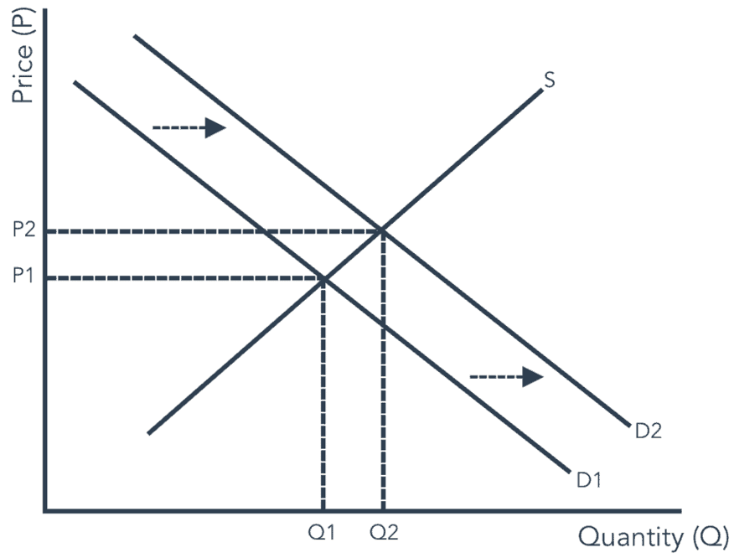
Shifts in demand
For example, the Coronavirus pandemic increased the market demand for face masks. This is a change in the non-price determinant of demand: special circumstances.
This causes demand to shift outwards (D1 to D2).
The market equilibrium changes from point A to B and the market equilibrium price increases from P1 to P2 and the market equilibrium quantity increases from Q1 to Q2. There has been an outward shift in demand resulting in a movement along the supply curve.
Market for Face Masks in Hong Kong
B
A

Slide 16
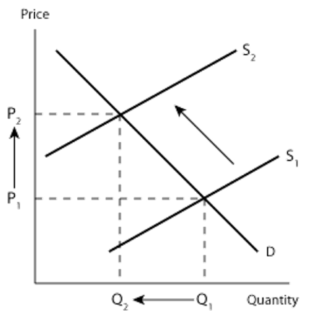
Shifts in supply
For example, the government imposes a sales tax on tobacco products. This is a change in the non-price determinant of supply: taxes.
This causes supply to shift inwards (S1 to S2).
The market equilibrium changes from point A to B and the market equilibrium price increases from P1 to P2 and the market equilibrium quantity decreases from Q1 to Q2. There has been an inward shift in supply resulting in a movement along the demand curve.
Market for Tobacco Products
B
A

Slide 17
Multiple choice question
Which statement explains why there might be a decrease in the demand for petrol?
A. An increasing number of drivers buy electric cars
B. Demand for new cars has increased
C. New technologies reduce the time needed to extract oil
D. There is an increase in world oil supplies.

Slide 18
Multiple choice question
The diagram below shows a change in the market for agricultural output. What is likely to have caused the change in supply?
Subsidies provided to farmers
Favourable weather conditions
Higher cost of fertilisers
Greater number of farmers
B
A

Slide 19
Multiple choice question
The diagram below shows a change in the market for smartphones. What is likely to have caused the change in demand?
A fall in the price of laptops
A lower sales tax on electronic goods
A reduction in income tax rates
A fall in the price of smartphones
B
A

Slide 20
Homework
Complete notes page 40-47
Answer questions in the chapter

Slide 21
Learning objectives

